Slide 1
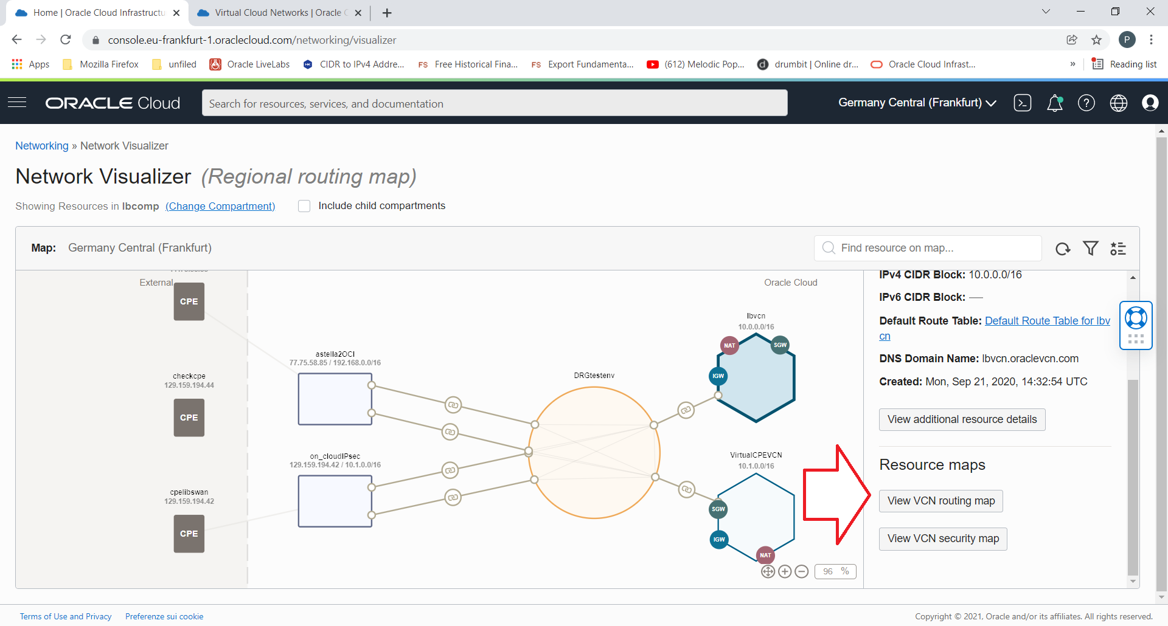
Network Visualizer

Slide 2
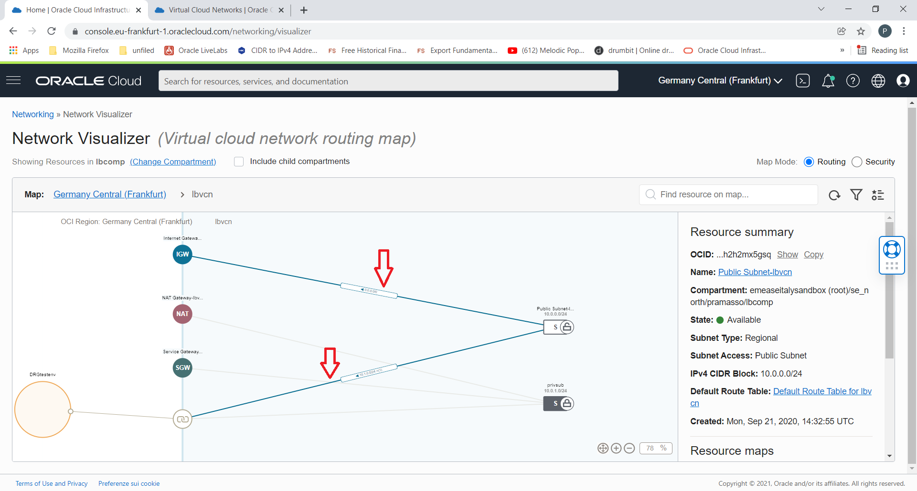
Network Visualizer

Slide 3
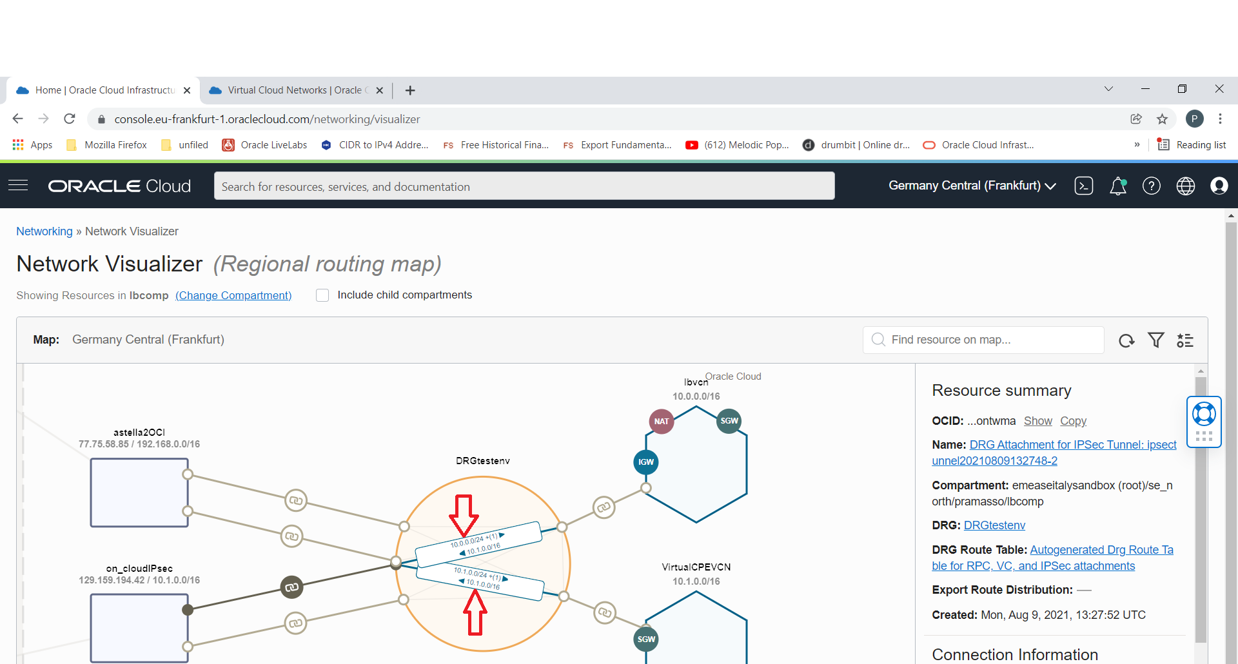
Network Visualizer and DRG Path Discovery

